Slide 1
{HIDDEN}
Quick Access Button
Sample Pit Presentation Tool
<Click Here!>

Slide 2
Main Menu
{HIDDEN}
Quick Access Button
1. Team Mission
Every slide has a “hidden” button that takes the user to a special slide containing quick links to specific slides that have visual aids for presenting to a judge or interested party.
2. Team Structure
All of the buttons on the left will link to the related section, allowing the user to instantly access whatever slide they want to view without having to scroll through the entire presentation.
For example, do you want to see our Future Plans? Easy! Just click it and you’re there with no extra hassle.
3. Engineering
4. Business
The “hidden” button should have the same fill color as your background with no text or outline, so that a normal user will not accidentally access it.
5. About Us
6. Future Plans

Slide 3
Team Mission
You can use this slide to display your mission statement, motto, or values.
{HIDDEN}
Quick Access Button
“To provide an inspiring learning environment that fosters growth and appreciation of science, technology, engineering, mathematics, and business knowledge, and to teach students skills vital to success in the real world through a strong relationship between students, mentors, and sponsors.”
Key Values
Hands on Learning with Mentors
Student Leadership
Outreach
{Back | Main Menu | Next}

Slide 4
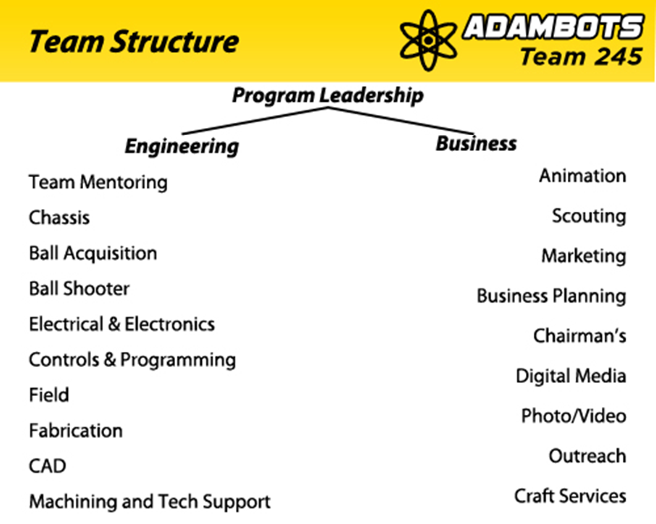
Team Structure
{HIDDEN}
Quick Access Button
Here you can explain how your team is structured.
Below is an example graphic from our 2014 Presentation.

Slide 5
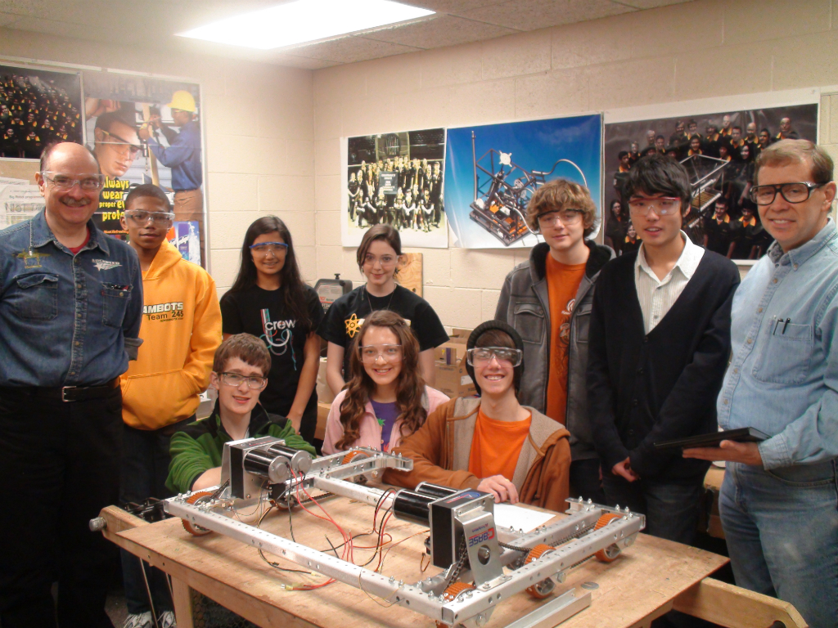
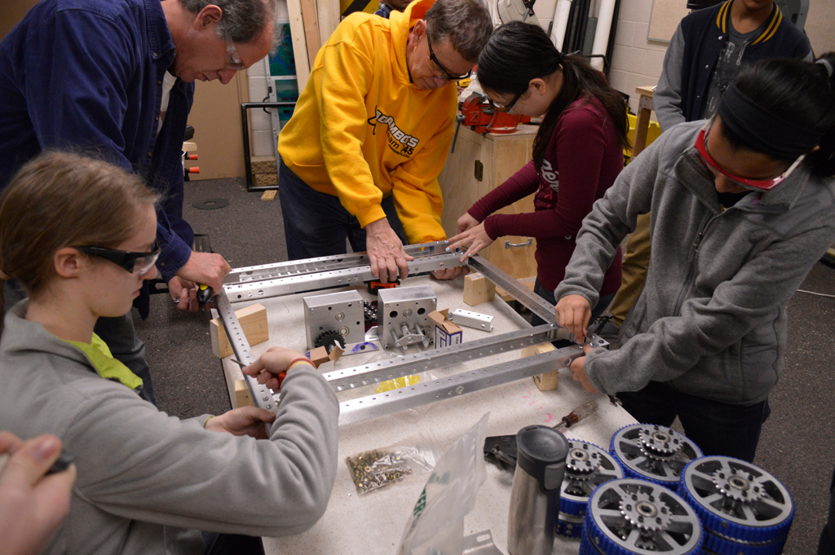
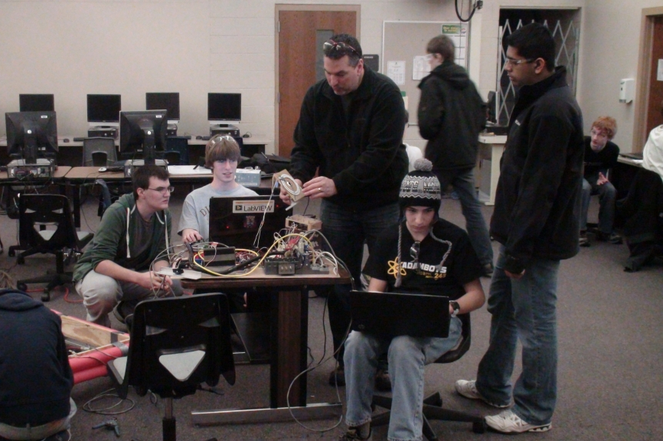
Engineering
{HIDDEN}
Quick Access Button
Here you can add information on the engineering aspect of your team.
We have a number of sub-teams related to Engineering.
Some of these include:
Chassis
Electronics
Programming
CAD

Slide 6
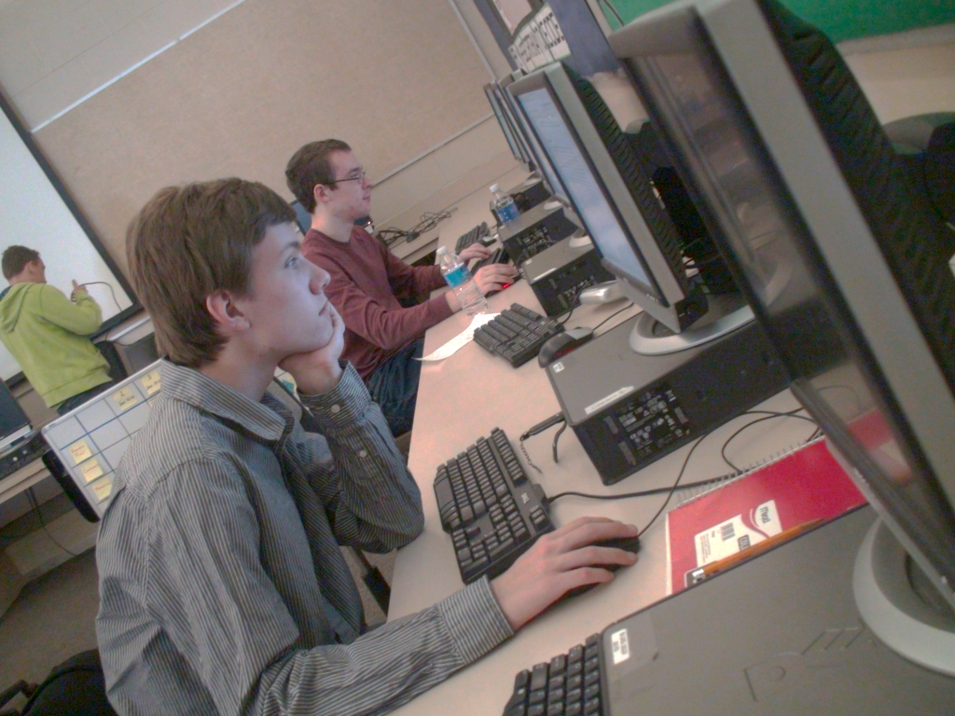
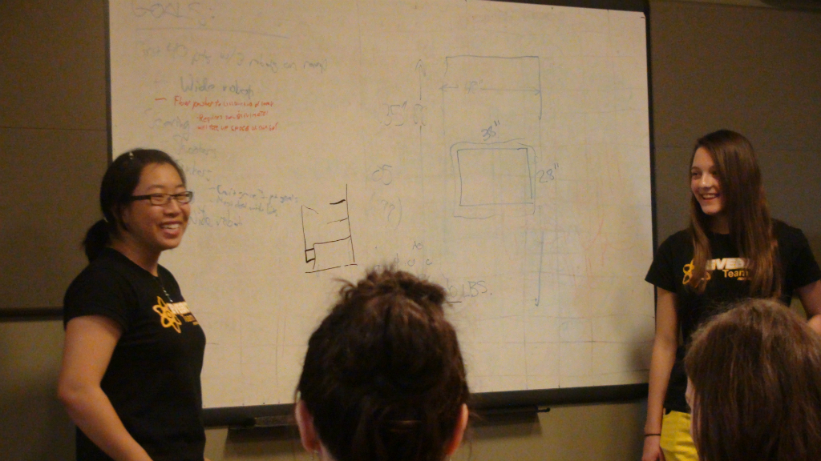
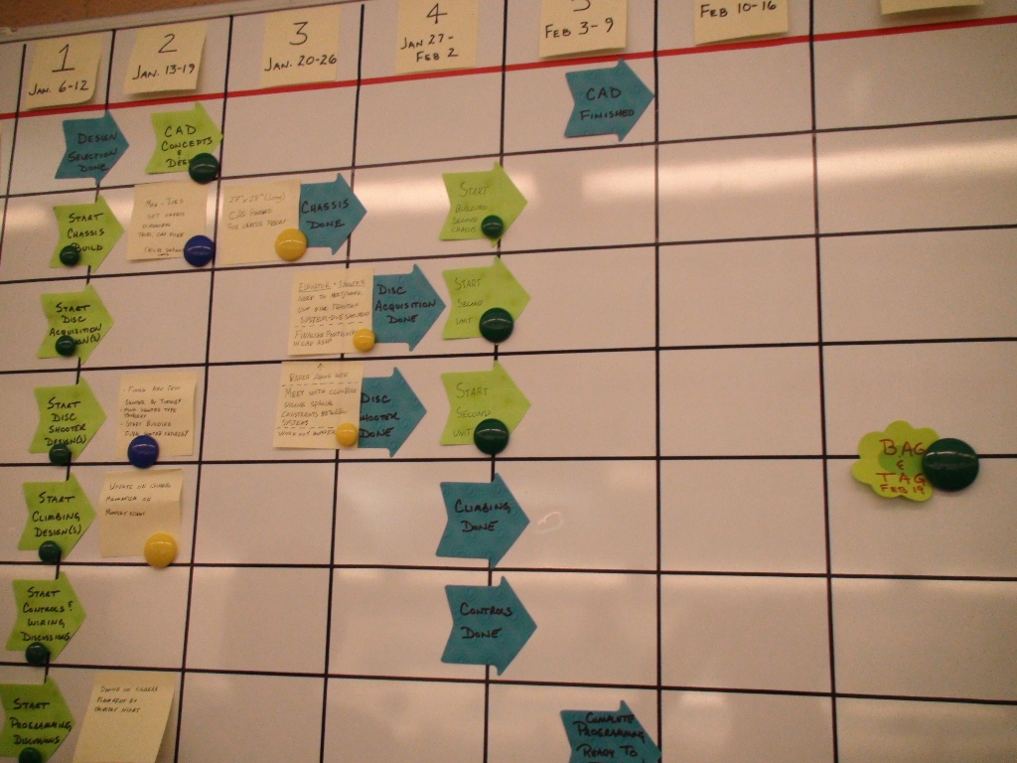
Business
{HIDDEN}
Quick Access Button
Here you can add information on the business aspect of your team.
We have a number of sub-teams related to Business.
Some of these include:
Business Plan
Project Management
Imagery
Social Media

Slide 7
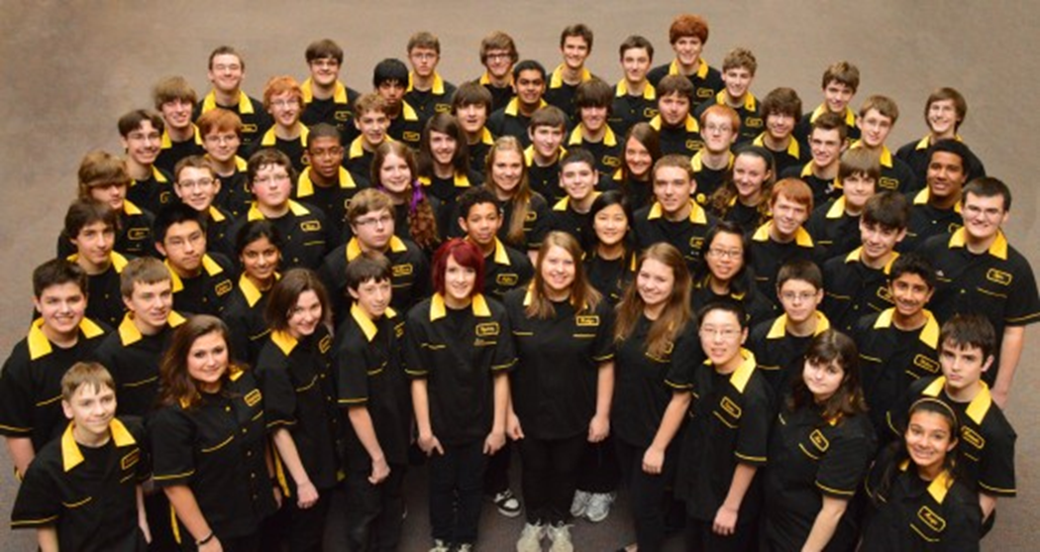
About Us
{HIDDEN}
Quick Access Button
Here you can tell us a bit about your team
Rookie Year: 1999
Location: Rochester Hills, Michigan, USA
School Affiliations: Rochester Adams High School
Students: 58
Mentors: 25
Sponsors: General Motors (Global Product Development), The FCA Foundation, R&G Drummer, Thyssenkrupp System Engineering, State of Michigan FRC Grant, APTIV, DTE, Friends and Family, Rochester Community Schools, Rochester Adams High School and Doolin and Haddad Dentistry.

Slide 8
Future Plans
Here you can talk about your team’s aspirations, ambitions, and goals
{HIDDEN}
Quick Access Button
Going forward, the AdamBots plan to:
X
Y
Z

Slide 9
{HIDDEN}
Quick Access Button
END OF PRESENTATION
<BACK TO START>

Slide 10
QUICK ACCESS
Mission Statement
Budget Info
Here is the “hidden” page, with buttons that you can use to link to important parts of the presentation.
Outreach
Risk Management

Slide 11
Mission Statement
{HIDDEN}
Quick Access Button
“To provide an inspiring learning environment that fosters growth and appreciation of science, technology, engineering, mathematics, and business knowledge, and to teach students skills vital to success in the real world through a strong relationship between students, mentors, and sponsors.”

Slide 12
Budget Info
{HIDDEN}
Quick Access Button
Short Summary of Budget Here

Slide 13
Outreach Summary
{HIDDEN}
Quick Access Button
Summary of Outreach Activities

Slide 14
Risk Management Summary
{HIDDEN}
Quick Access Button
Information on our Risk Management Summary

